Slide 1


Made by Thai An Nguyen
The Journey To Understand Happiness
A presentation

Slide 2


Index
PERSONAL INFORMATION
REASON BEHIND THE CREATION
TOOLS
DESIGN
DEMO
Q&A

Slide 3



1. Personal Information
NAME: Nguyen Thai An
CLASS: 10D1
SCHOOL: Yen Hoa High School
HOBBIES & FAVORITE: Video games; Listen to music; Watching film; Read books

Slide 4

2. REASON BEHIND THE CREATION

Slide 5






3. TOOLS
HTML 5
CSS
Java Script
Pixlr Editor
Adobe Illustrator

Slide 6

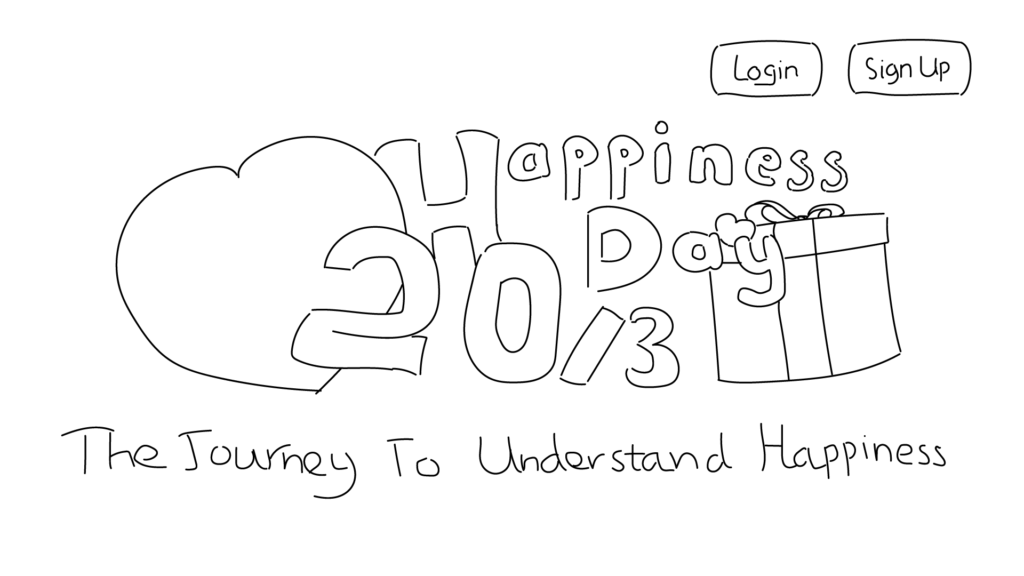
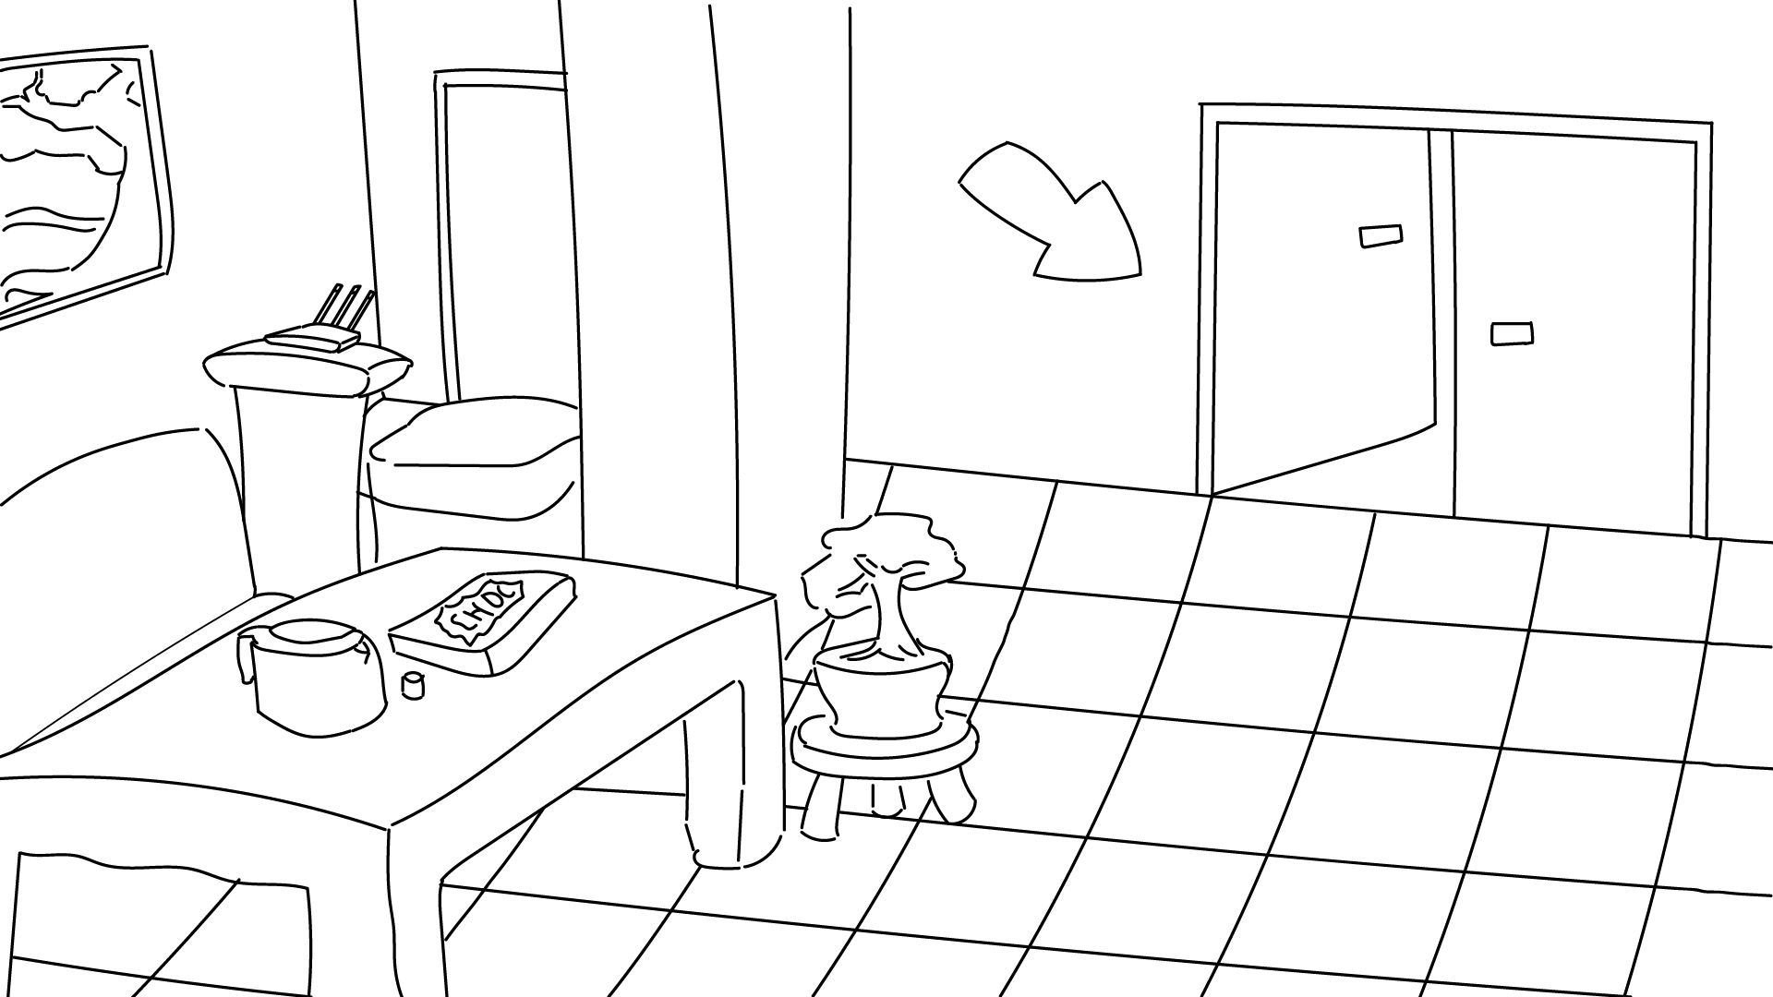
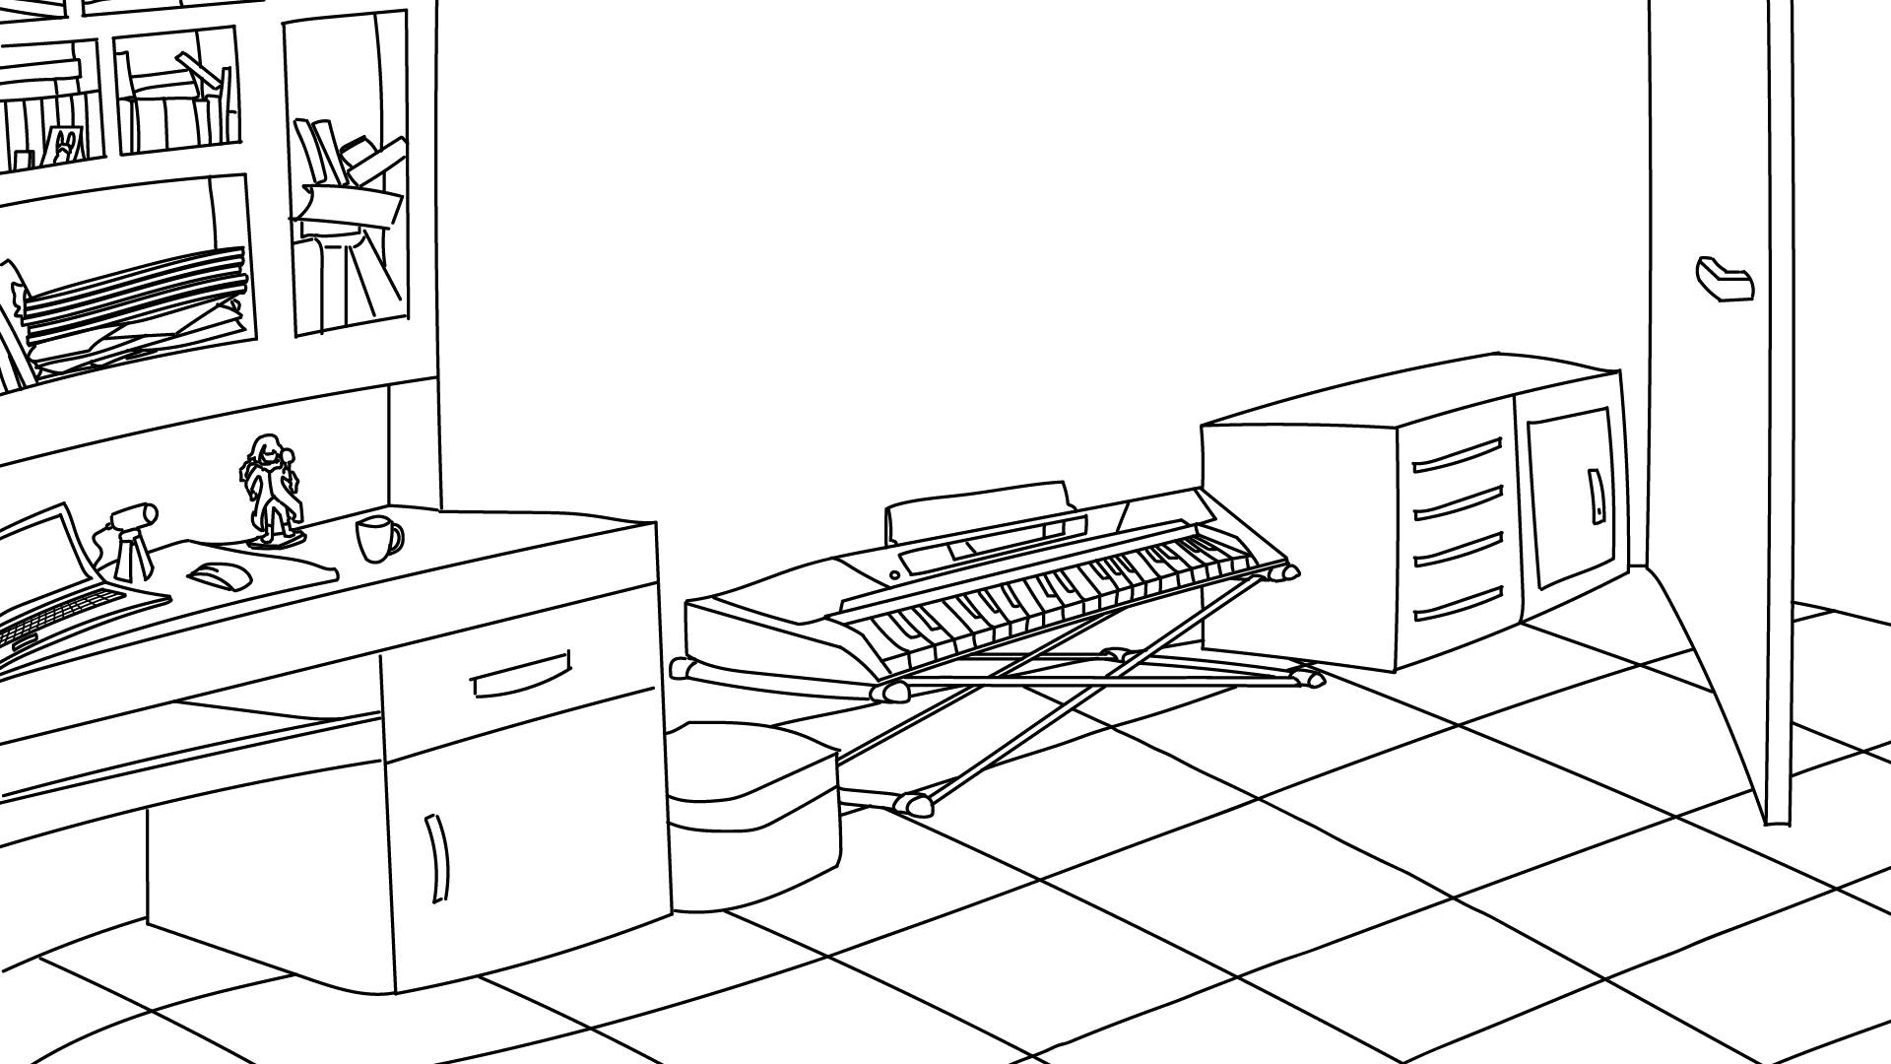
4. DESIGN

Slide 7

5. DEMO

Slide 8

6. Q&A
Answering questions

Slide 9
Thank you for
participate in this lesson
And goodbye!

